Slide 1

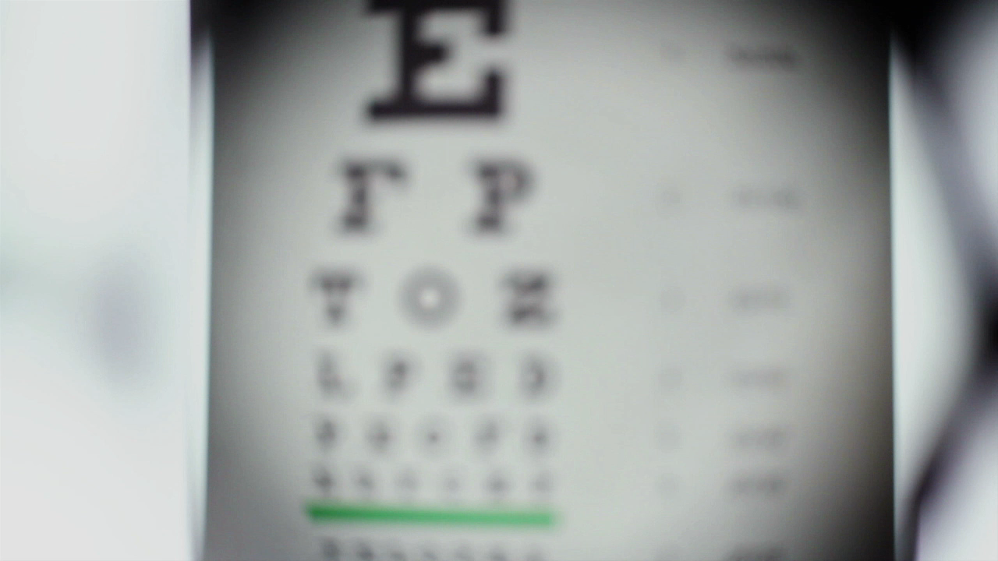
OBJECT DETECTION USING DEEP LEARNING
Harsha Vardhan Mahankali - 00826377
shivapriya Pillalamarri - 00905151
Instructor- Shivanjali Khare

Slide 2
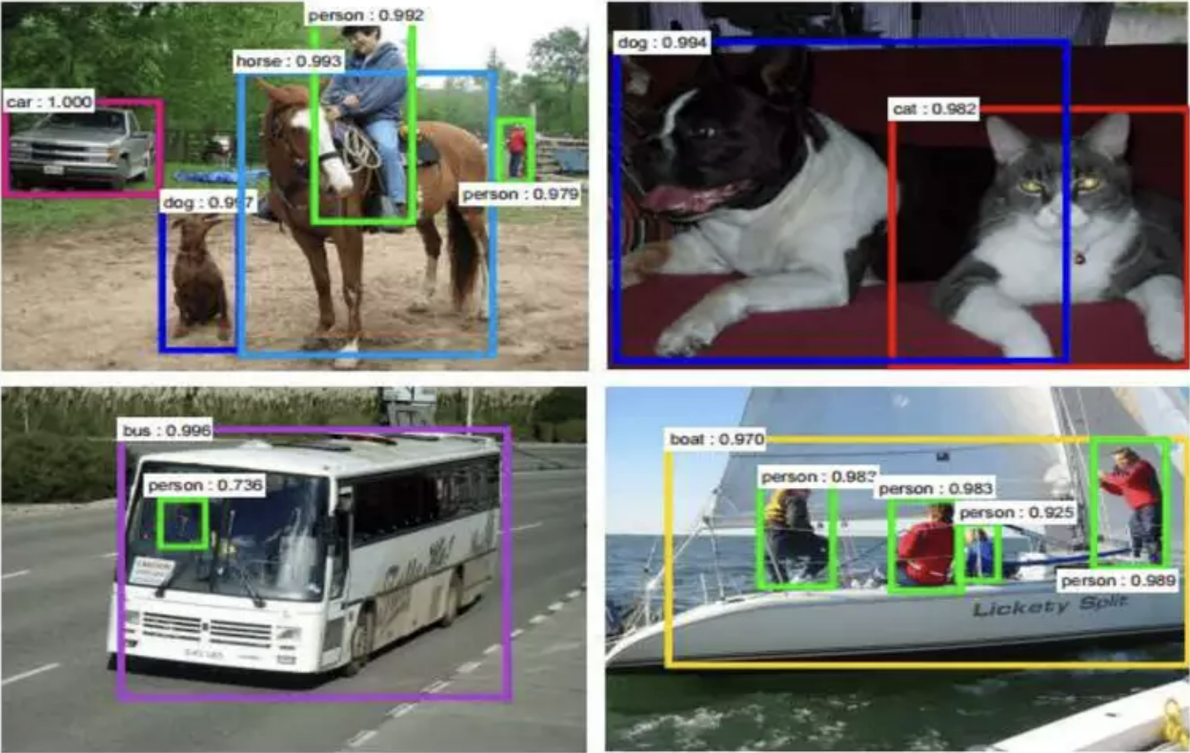
Introduction
Object detection is the process of identifying and locating objects in images or videos.

Slide 3
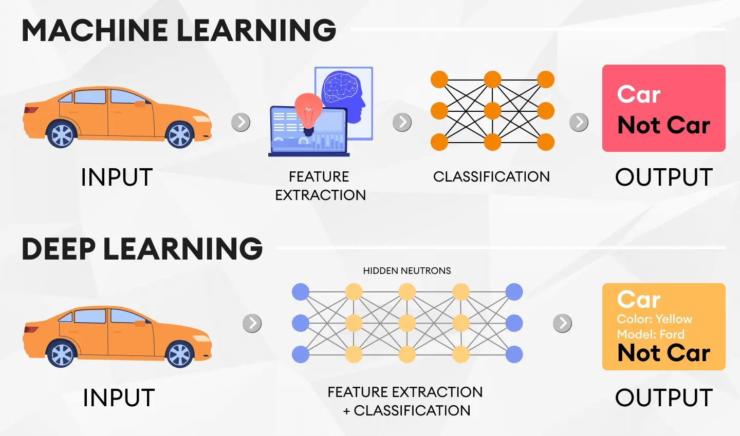
Introduction to Deep Learning

Slide 4

Deep Learning Frameworks

Slide 5
Object Detection Algorithms:
Histogram of Oriented Gradients(HOG)
Singe Shot Detector(SSD)
Convolutional Neural Networks (CNN)
YOLO(You Only Look Once)

Slide 6
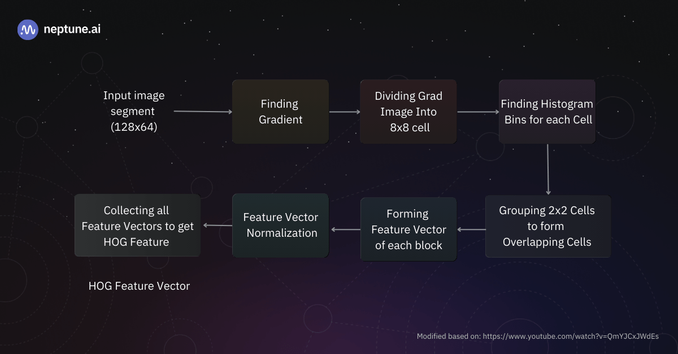
Histogram of Oriented Gradients(HOG)

Slide 7
Limitations
While the Histogram of Oriented Gradients (HOG) was quite revolutionary in the beginning stages of object detection, there were a lot of issues in this method.
It’s quite time-consuming for complex pixel computation in images, and ineffective in certain object detection scenarios with tighter spaces.

Slide 8
When to use HOG?
HOG should often be used as the first method of object detection to test other algorithms and their respective performance.
Regardless, HOG finds significant use in most object detection and facial landmark recognition with decent accuracy.
Example to use cases:
One of the popular use cases of HOG is in pedestrian detection due to its smooth edges.
Other general applications include object detection of specific objects.

Slide 9
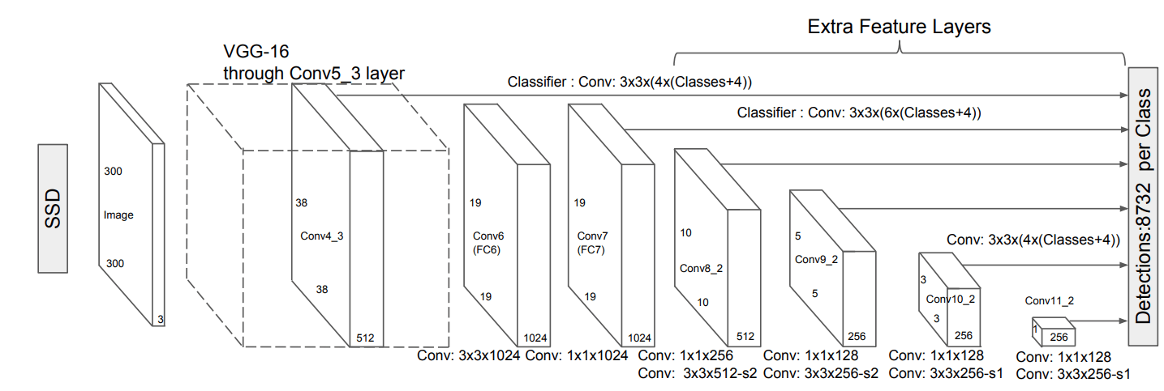
Singe Shot Detector(SSD)

Slide 10
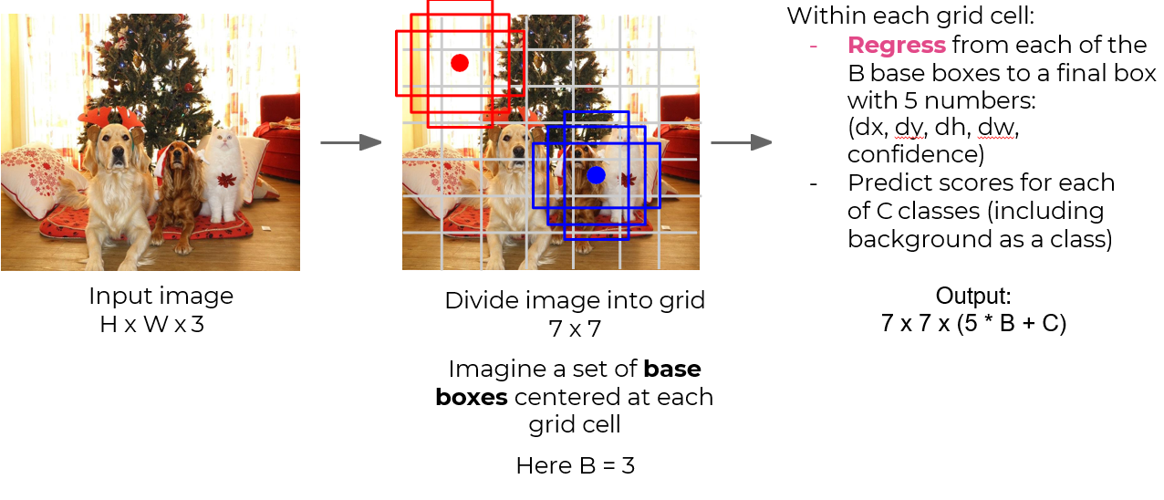
When to use SSD?
The single-shot detector is often the preferred method.
The main reason for using the single-shot detector is because we mainly prefer faster predictions on an image for detecting larger objects, where accuracy is not an extremely important concern.
However, for more accurate predictions for smaller and precise objects, other methods must be considered.

Slide 11
Limitations:
The SSD, while boosting the performance significantly, suffers from decreasing the resolution of the images to a lower quality.
The SSD architecture will typically perform worse than the Faster R-CNN for small-scale objects.

Slide 12
Example to use cases:
The Single-shot detector can be trained and experimented on a multitude of datasets, such as PASCAL VOC, COCO, and ILSVRC datasets.
They can perform well on larger object detections like the detection of humans, tables, chairs, and other similar entities.

Slide 13
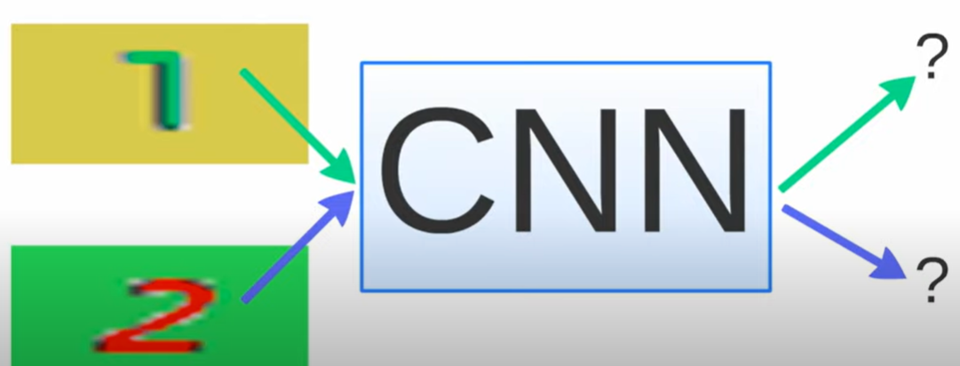
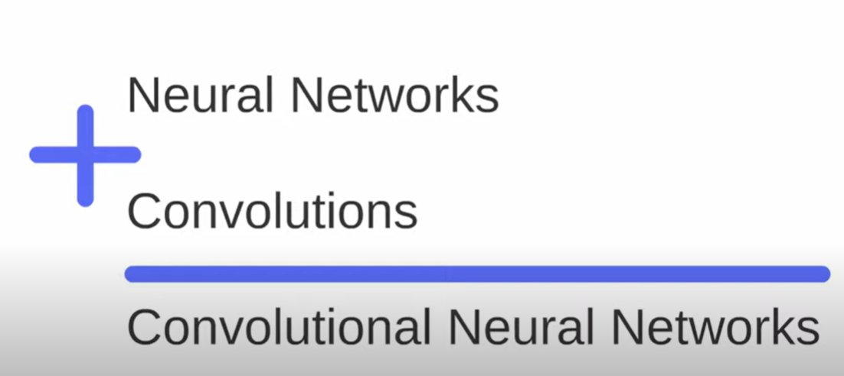
Convolutional Neural Networks (CNN)
CNN were first developed and used around the 1980s.
Convolutional Neural Networks are deep learning models designed specifically for processing & analyzing visual data such as images & videos.

Slide 14
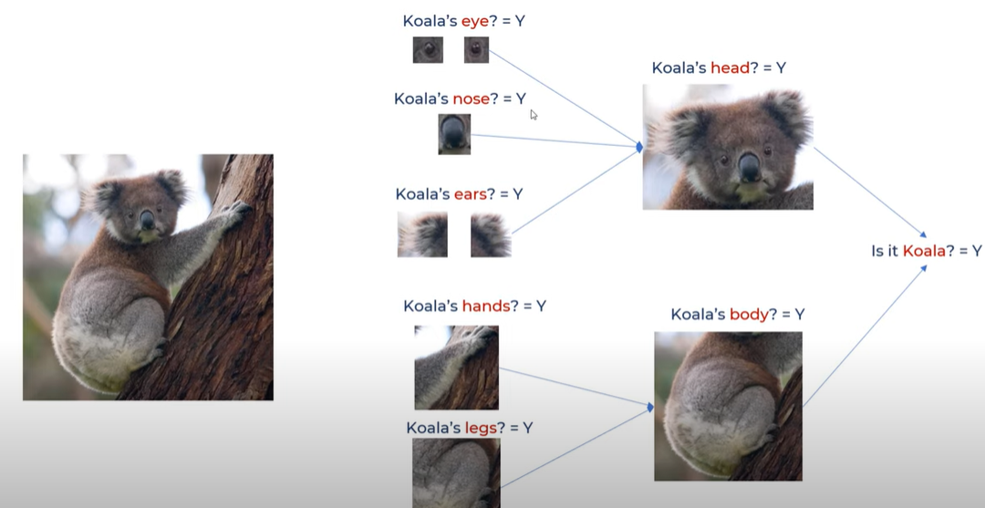
Key components of a Convolutional Neural Network include: * Convolutional Layers * Pooling Layers * Fully Connected Layers

Slide 15
Advantages of CNN
High Accuracy at image recognition
No human supervision
Disadvantages of CNN
A lot of training data is needed
Training process takes a long time

Slide 16
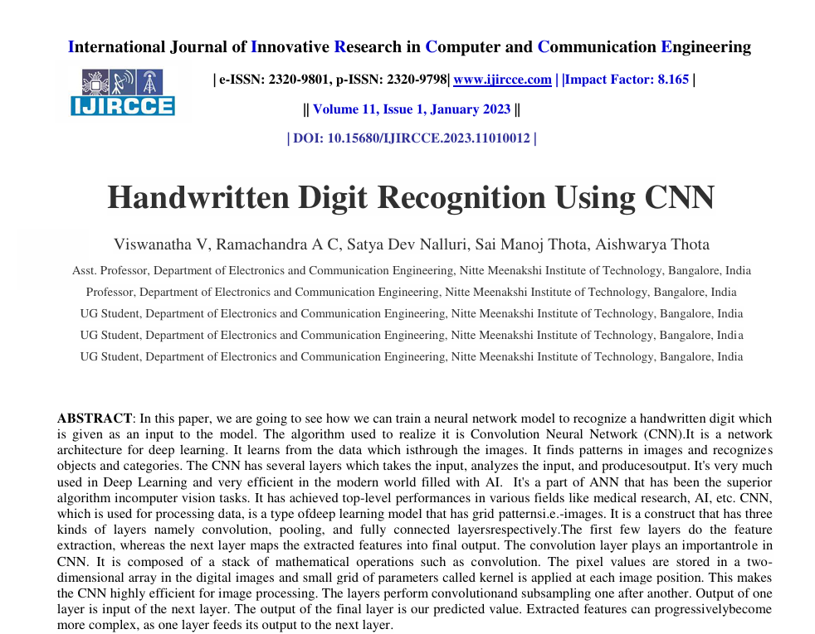
Application of CNN

Slide 17


Slide 18
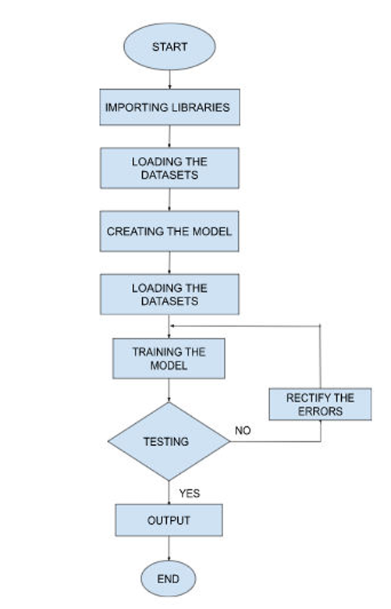
Flowchart

Slide 19
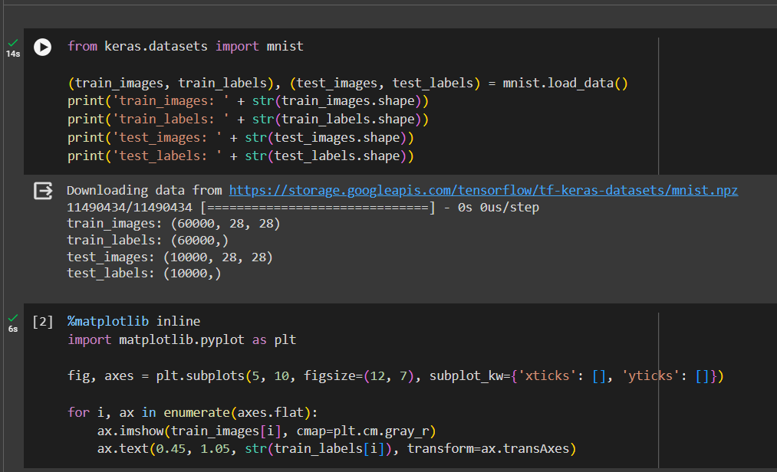

Slide 20
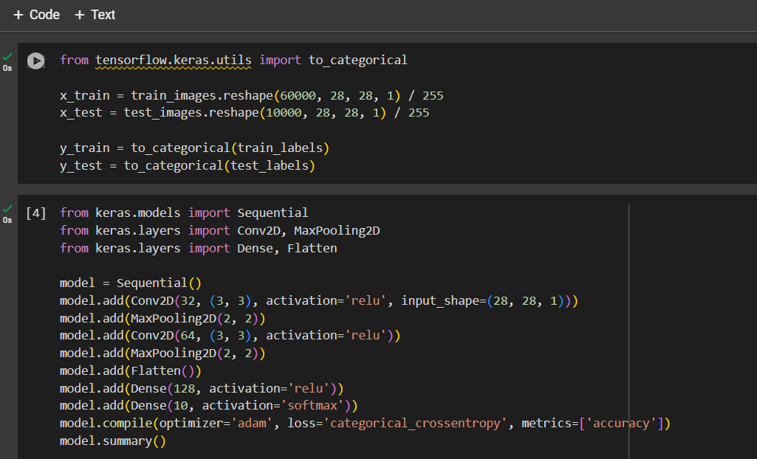

Slide 21

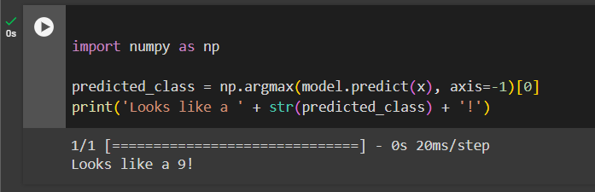


Slide 22

Code Implementation Video

Slide 23

YOLO(You Only Look Once)
YOLO (You Only Look Once) is a real-time object detection algorithm developed by Joseph Redmon and Ali Farhadi in 2015.
It is a single-stage object detector that uses a convolutional neural network (CNN) to predict the bounding boxes and class probabilities of objects in input images. YOLO was first implemented using the Darkent framework.

Slide 24
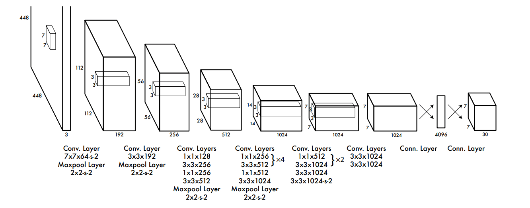
Structure of YOLO:

Slide 25
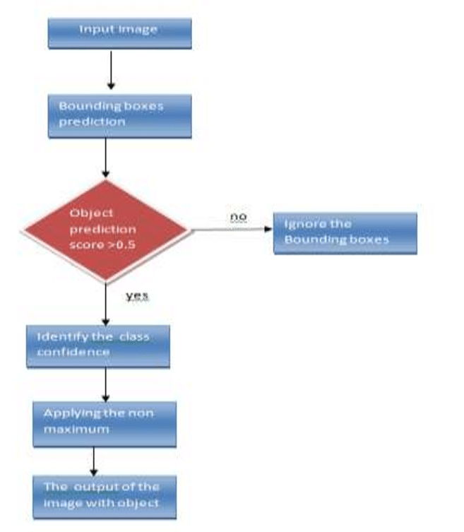
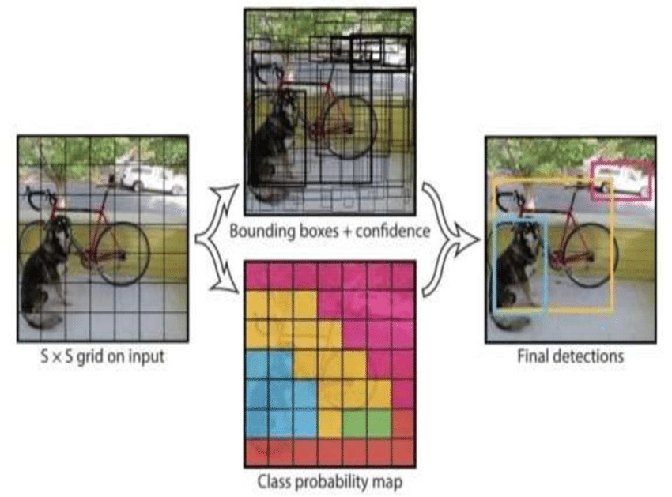
Flow chart

Slide 26
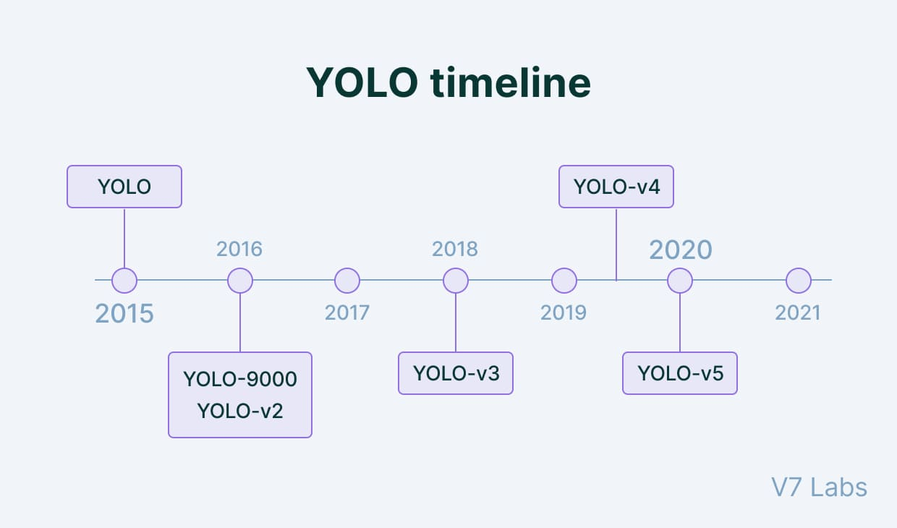
Versions of YOLO:
YOLO has been developed in several versions, such as YOLOv1, YOLOv2, YOLOv3, YOLOv4, YOLOv5, YOLOv6, and YOLOv7. Each version has been built on top of the previous version with enhanced features such as improved accuracy, faster processing, and better handling of small objects.

Slide 27
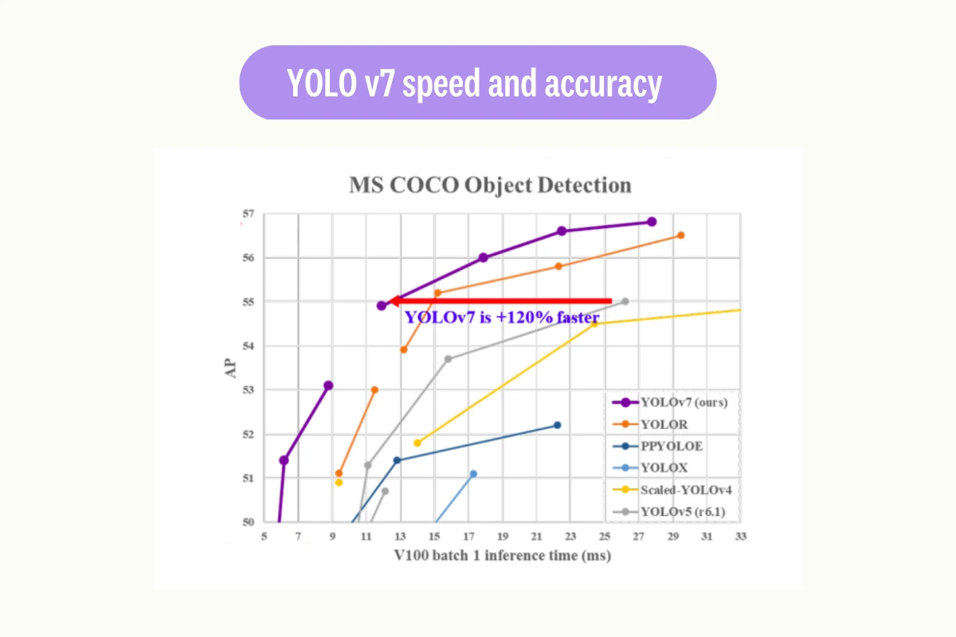
YOLO V7:

Slide 28
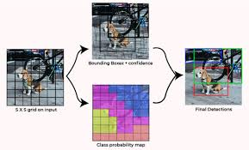
Advantages of YOLO :
Real-time object detection
High Accuracy
Single-shot detection
Good performance on small objects
Efficient use of GPUs
Ability to handle multiple scales

Slide 29
Limitations:
Limited to object detection
Less accurate than some other methods
Struggles with very small objects
No tracking capability

Slide 30
Conclusion:
Object detection is still one of the most essential deep learning and computer vision applications to date. We’ve seen a lot of improvements and advancements in the methodologies of object detection.
It started with algorithms like the Histogram of Oriented Gradients, introduced way back in 1986 to perform simple object detections on images with decent accuracy. Now, we have modern architectures such as Faster R-CNN, Mask R-CNN, YOLO.
The restrictions for object detection are not limited to images, as they can be effectively performed on videos and real-time footage with high accuracy. In the future, a lot more successful algorithms and libraries for object detection still await us.

Slide 31


